Slide 1
Disk Scheduling

Slide 2
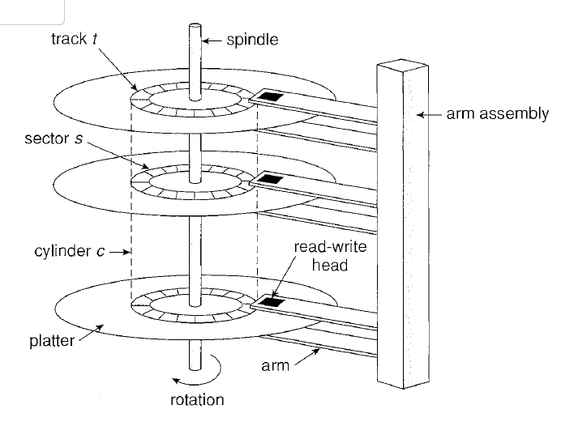

Slide 3
Disk Scheduling
The operating system is responsible for using hardware efficiently — for the disk drives, this means having a fast access time and disk bandwidth.
Access time has two major components
  Seek time is the time for the disk are to move the heads to the cylinder containing the desired sector.
  Rotational latency is the additional time waiting for the disk to rotate the desired sector to the disk head.
Minimize seek time
Seek time ≈ seek distance
Disk bandwidth is the total number of bytes transferred, divided by the total time between the first request for service and the completion of the last transfer.

Slide 4
Disk Scheduling (Cont.)
Several algorithms exist to schedule the servicing of disk I/O requests.
We illustrate them with a request queue (0-199).
98, 183, 37, 122, 14, 124, 65, 67
Head pointer 53

Slide 5

FCFS
Illustration shows total head movement of 640 cylinders.

Slide 6
SSTF
Selects the request with the minimum seek time from the current head position.
SSTF scheduling is a form of SJF scheduling; may cause starvation of some requests.
Illustration shows total head movement of 236 cylinders.

Slide 7

SSTF (Cont.)

Slide 8
SCAN
The disk arm starts at one end of the disk, and moves toward the other end, servicing requests until it gets to the other end of the disk, where the head movement is reversed and servicing continues.
Sometimes called the elevator algorithm.
Illustration shows total head movement of 208 cylinders.

Slide 9
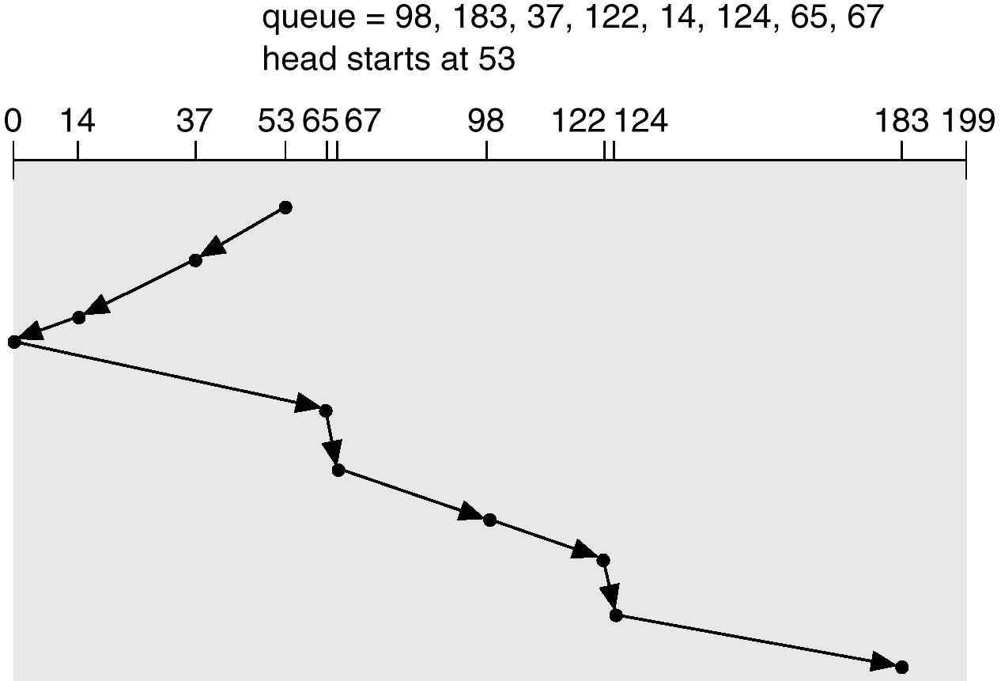
SCAN (Cont.)

Slide 10
C-SCAN
Provides a more uniform wait time than SCAN.
The head moves from one end of the disk to the other. servicing requests as it goes. When it reaches the other end, however, it immediately returns to the beginning of the disk, without servicing any requests on the return trip.
Treats the cylinders as a circular list that wraps around from the last cylinder to the first one.

Slide 11

C-SCAN (Cont.)

Slide 12
C-LOOK
Version of C-SCAN
Arm only goes as far as the last request in each direction, then reverses direction immediately, without first going all the way to the end of the disk.

Slide 13

C-LOOK (Cont.)

Slide 14
Selecting a Disk-Scheduling Algorithm
SSTF is common and has a natural appeal
SCAN and C-SCAN perform better for systems that place a heavy load on the disk.
Performance depends on the number and types of requests.
Requests for disk service can be influenced by the file-allocation method.
The disk-scheduling algorithm should be written as a separate module of the operating system, allowing it to be replaced with a different algorithm if necessary.
Either SSTF or LOOK is a reasonable choice for the default algorithm.

Slide 15
Suppose that a disk drive has 5,000 cylinders, numbered 0 to 4,999. The drive is currently serving a request at cylinder 2,150, and the previous request was at cylinder 1,805. The queue of pending requests, in FIFO order, is:
2,069, 1,212, 2,296, 2,800, 544, 1,618, 356, 1,523, 4,965, 3681
Starting from the current head position, what is the total distance (in cylinders) that the disk arm moves to satisfy all the pending requests for each of the following disk-scheduling algorithms?
a. FCFS
b. SSTF
c. SCAN
d. LOOK
e. C-SCAN
f. C-LOOK

